Slide 1

32555 – Fundamentals of Software Development

Slide 2
Welcome to 32555 – Fundamentals of Software Development
Your Teaching Team:
Dr. Yining Hu | Subject Coordinator
Yining is a Lecturer in Software Engineering. She works with many SMEs to develop software and AI solutions through student and research projects at UTS.
Contact: yining.hu@uts.edu.au
Dr. Xiaojie (Zoe) Lin | Tutor
Zoe is a full-stack software engineer with an interest in data analysis, specializing in JAVA, R, Python, JavaScript, PHP, Bash, and MATLAB; familiar with AWS.
Contact: Xiaojie.Lin@uts.edu.au
Dr. Farshid Keivanian | Tutor
Dr. Farshid Keivanian is an experienced university lecturer and researcher with a PhD in Information Technology. He has over 15 years of teaching experience across Australian institutions, specialising in software engineering, data science, AI, and cybersecurity.
Contact: Farshid.Keivanian@uts.edu.au
Yong Pov | Tutor
Yong is a full-stack software engineer with experience in React, JavaScript, TypeScript, Java, Python, SQL, and AI-assisted learning platforms.
Contact: Yong.Pov@uts.edu.au

Slide 3
Welcome to 32555 – Fundamentals of Software Development
Cmp1 # | Location | Time | Tutor
01 | CB11.B1.400 | Fri 16:00-18:00 | Xiaojie (Zoe) Lin
07 | CB11.B1.401 | Wed 10:00-12:00 | Farshid Keivanian
08 | CB11.B1.400 | Fri 12:00-14:00 | Yong Pov
09 | CB11.B1.103 | Wed 16:00-18:00 | Farshid Keivanian
10 | CB11.B1.401 | Wed 12:00-14:00 | Farshid Keivanian

Slide 4
Week 11 Outline
Question and Answer about Presentation (Showcase Part)
Introduction to JavaFX
Creating Your First JavaFX Window and Handling Common Errors
MQs designed in Week 11 (JavaFX)

Slide 5
Question and Answer about Presentation (Showcase Part)
Presentation Guidelines
Each group will have 15 minutes in total (including Q&A). Within this time, please ensure the following:
Present the working software (CLI and/or GUI) live.
Each member should explain their own code contribution (around 2–3 minutes each).
Demonstrate all key functionalities (register/login, enrol/remove subjects, file operations, admin features, etc.).
Be prepared for a brief Q&A at the end — I’ll ask 1–2 short questions to confirm understanding and contribution.

Slide 6
Question and Answer about Presentation (Showcase Part)
Please select your preferred online presentation timeslot between 5:15 PM and 7:15 PM (Tuesday, 28th Oct), and I’ll confirm it in the schedule.
Kind regards,
Farshid Keivanian
Fundamentals of Software Development

Slide 7
Question and Answer about Presentation (Showcase Part)
Dear Prof. Farshid,
I hope you’re doing great. I wanted to follow up regarding the remote quiz and also clarify what exactly needs to be covered in the video for our presentation particularly the questions or sections I need to answer.
As I mentioned earlier, I’m flying back due to some unavoidable professional work related to my startup(on 7th Oct, FSD lab 4:00 PM - 6:00 PM). I’ll make sure to stay updated with the class and complete all required components remotely. As per our last discussion and last mail that you’ll be sharing the code with me on the day for the remote quiz just wanted to confirm if there’s anything specific I should prepare for that.
Thank you so much for your understanding and support.
Best regards

Slide 8
Question and Answer about Presentation (Showcase Part)
Dear Pranav,
Thanks for the update, and noted on your travel for the startup work.
I will include the quiz code in the Week 12 slides, and I’ll also share a Microsoft Teams link with you to join for your showcase presentation.
Please send me an email (and cc your group members if applicable) to confirm which week you plan to present — Week 12 or Week 13.

Slide 9
Question and Answer about Presentation (Showcase Part)
What to Cover for Solo Presentation
Each student completing the showcase individually should include the following in their video or live demo:
Intro (10–15s): Your name, student ID, group number, and your role(s).
Live demo (2–3 min): Show the running app (CLI and/or GUI) performing key tasks you worked on.
Your code walkthrough (2–3 min):
  Classes/methods you implemented (e.g., enrol/remove, file I/O, regex validation, grouping/partitioning).
  How your code fits within the Model–Controller–(View) design.
  Any exception handling or edge cases you addressed.

Slide 10
Question and Answer about Presentation (Showcase Part)
Testing & evidence (30–60s): Show sample I/O matching the specification or explain your testing approach.
Reflection (30–45s): Briefly mention the biggest challenge you faced, how you solved it, and one possible improvement.
Length: Approximately 5–7 minutes in total.

Slide 11
Question and Answer about Presentation (Showcase Part)
Please also confirm the following:
That you have Microsoft Teams access for the quiz.
Your preferred language/IDE (Java or Python) so I can tailor the starter code accordingly.
Kind regards,
Farshid Keivanian
Fundamentals of Software Development

Slide 12
Question and Answer about Presentation (Showcase Part)
Question from Students on Friday Class (12 PM – 2 PM)
Can we present it in first half of week 12 (24th Oct)?
Yes, just send me an email, cc your group members and confirm a timeslot (e.g., 12:15 PM to 12:30 PM, or 12:30 to 12:45 PM)

Slide 13
Question and Answer about Presentation (Showcase Part)
Some students have asked whether they can present during the student vacation week (31st October).
Generally, this is not advised, as no official class sessions are scheduled during that week. However, if your group strongly prefers to present then, please send me an email (and cc all group members) to confirm your availability for online presentation and select a timeslot such as:
12 PM – 12:15 PM, 12:15 PM – 12:30 PM, …, or 1:45 PM – 2 PM
I’ll review the requests and confirm your presentation time accordingly.

Slide 14
Introduction to JavaFX
JavaFX helps us create modern and interactive user interfaces for Java programs.
It works smoothly in tools like IntelliJ, VS Code, and NetBeans.
Think of it like the front desk at UTS – it’s the friendly face that connects users with the main system behind the scenes.

Slide 15
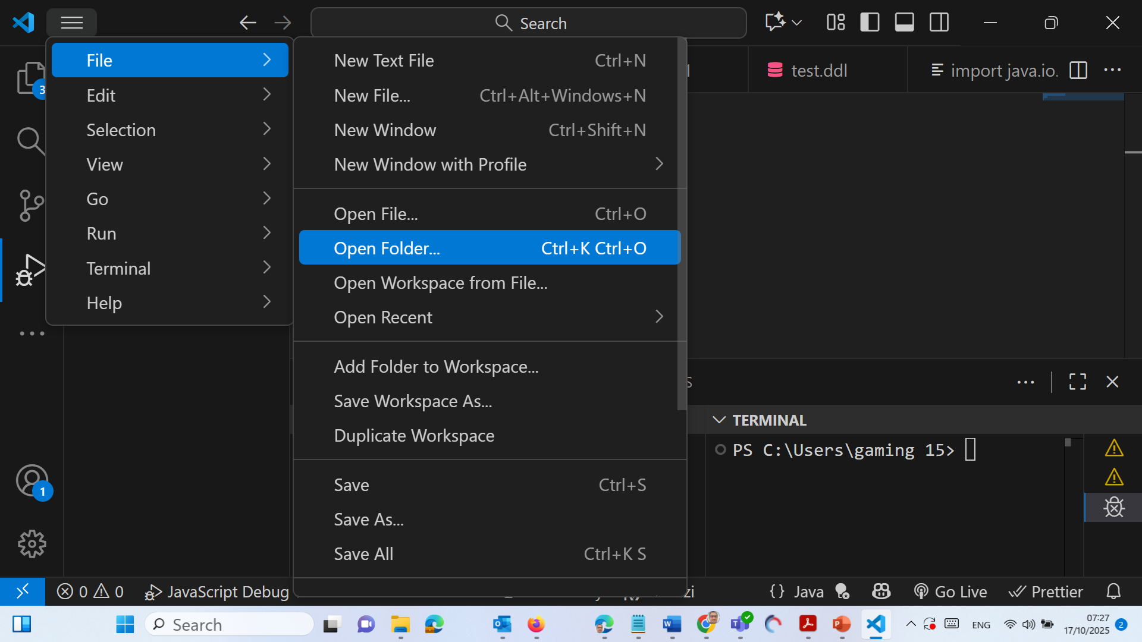
Creating Your First JavaFX Window and Handling Common Errors
In VS Code → click ‘Open Folder’ (on the left sidebar)

Slide 16
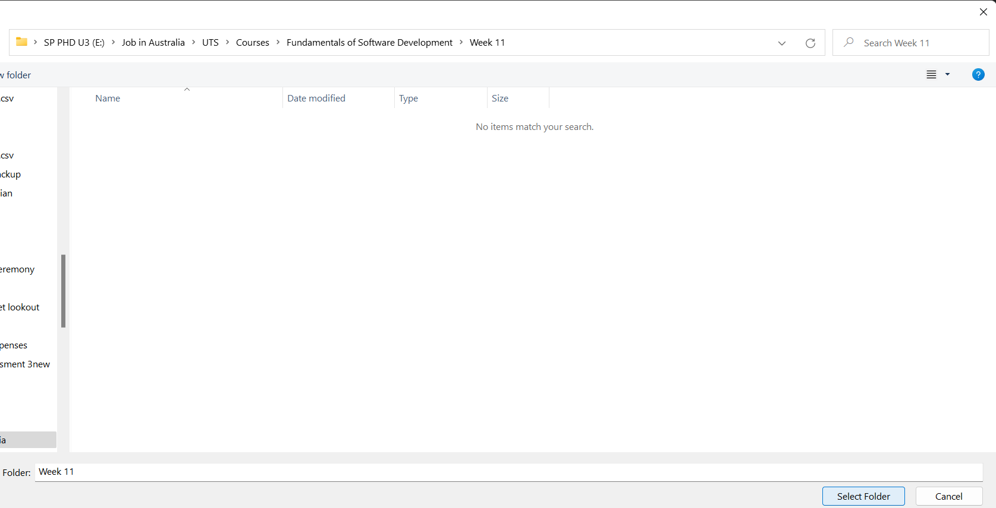
Creating Your First JavaFX Window and Handling Common Errors
Create or open a folder like:
C:\Users\<YourName>\JavaFXProjects\Week11 (or similar)
Save your file inside this folder (e.g., HelloFX.java).
If you see “No folder opened” on the left — VS Code can’t build/run anything.

Slide 17
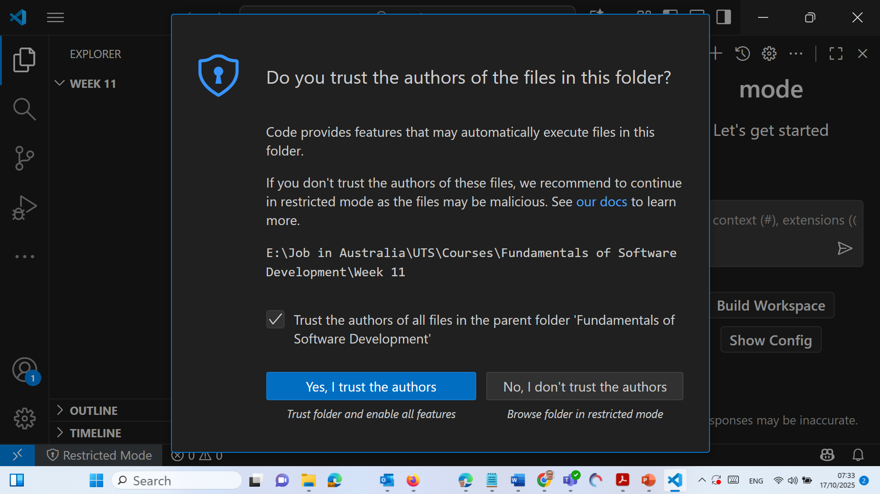
Creating Your First JavaFX Window and Handling Common Errors
Check Trust and Click Yes, I trust the authors

Slide 18
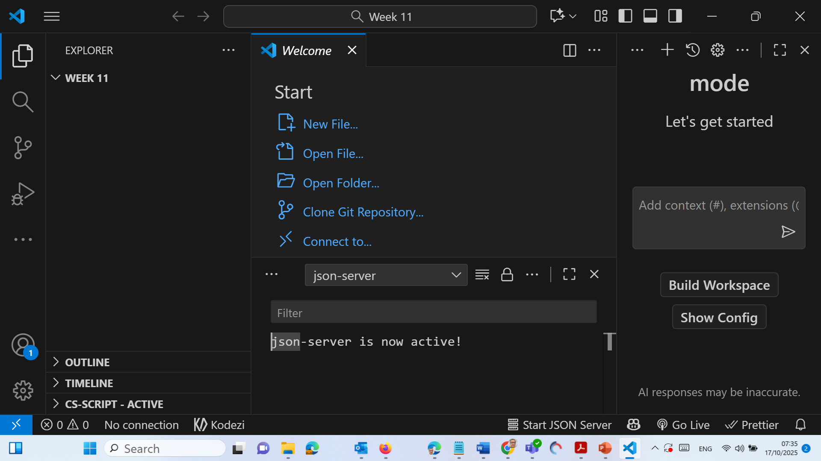
Creating Your First JavaFX Window and Handling Common Errors
You will see this folder and welcome message

Slide 19
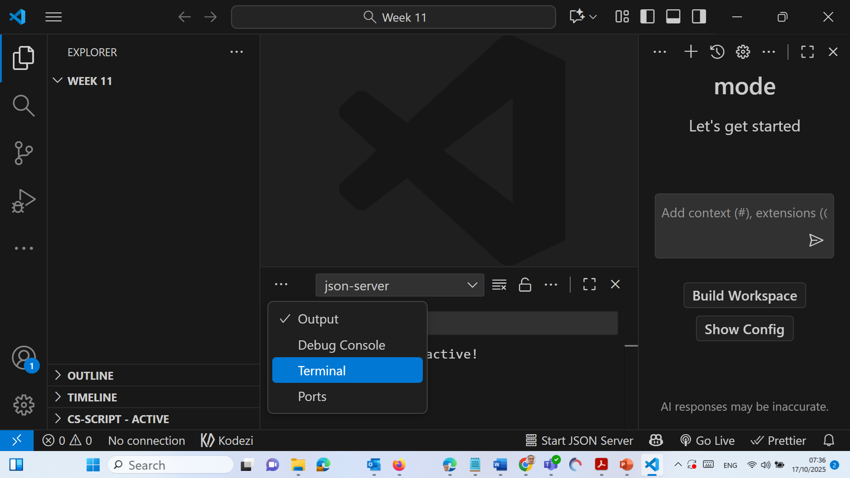
Creating Your First JavaFX Window and Handling Common Errors
Select Terminal

Slide 20
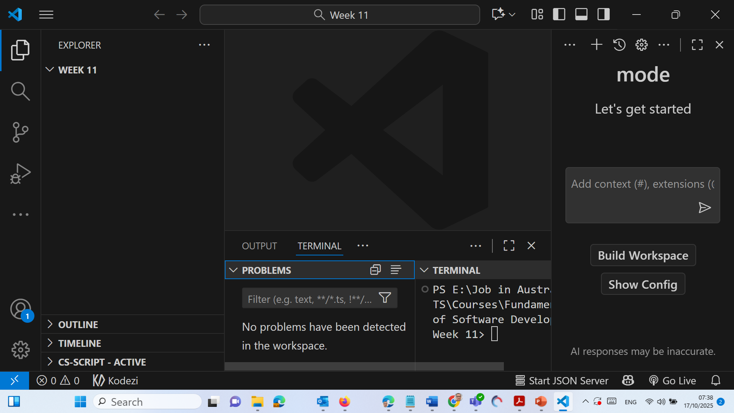
Creating Your First JavaFX Window and Handling Common Errors
Click on Arrow to minimise it

Slide 21
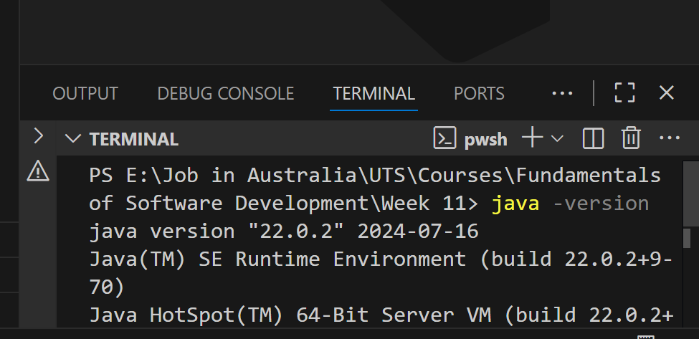
Creating Your First JavaFX Window and Handling Common Errors
Check You Have These Installed
In VS Code terminal:
java -version
javac -version
….\Week 11> java -version
java version "22.0.2" 2024-07-16
Java(TM) SE Runtime Environment (build 22.0.2+9-70)
Java HotSpot(TM) 64-Bit Server VM (build 22.0.2+9-70, mixed mode, sharing)

Slide 22
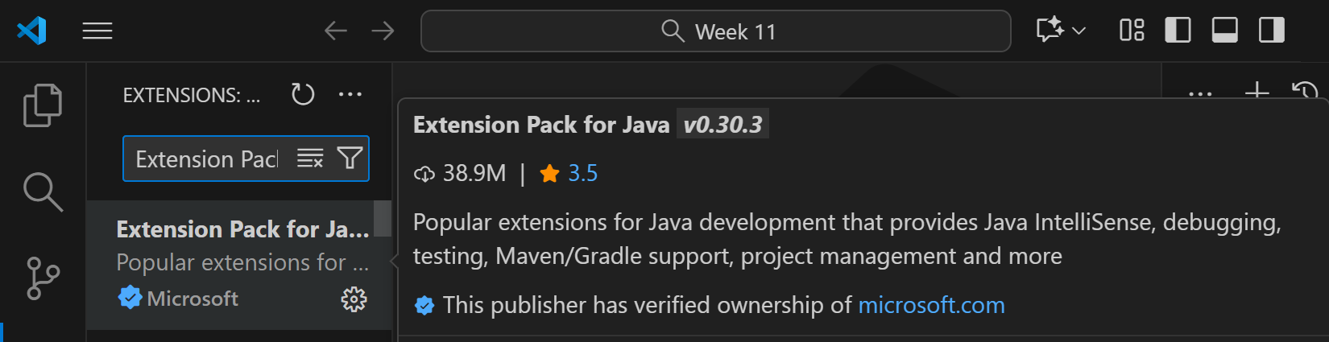
Java 22 installation is excellent for all Week 11 / Part 2 / Part 3 JavaFX work.
Install Required Extensions
Go to Extensions (Ctrl+Shift+X) and make sure these are installed:
Extension Pack for Java
Why: Installs all the key Java tools together — saves setup time and ensures your IDE supports coding, compiling, debugging, Maven, and project management (all needed for CLI and GUI apps).

Slide 23
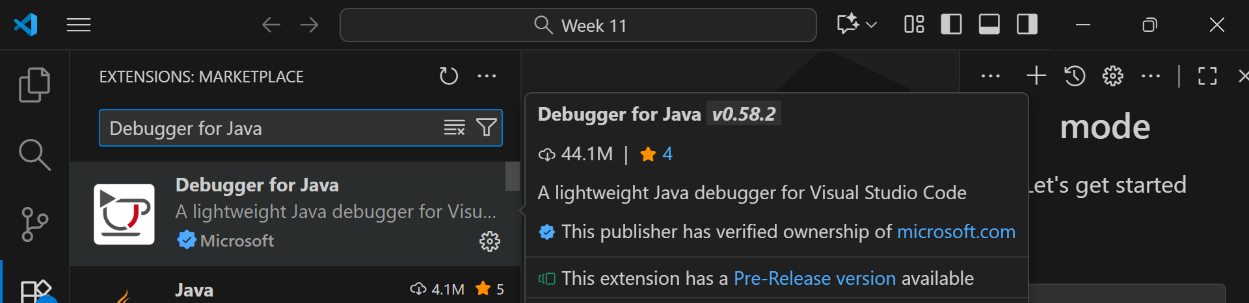
Creating Your First JavaFX Window and Handling Common Errors
Debugger for Java (Always install “Debugger for Java” by Microsoft, not Oracle. Oracle is old and no longer maintained)
Why: Lets you run and step through your JavaFX or CLI app line-by-line to check logic, handle runtime errors, and verify GUI event flow — essential for testing your login/enrolment systems.

Slide 24
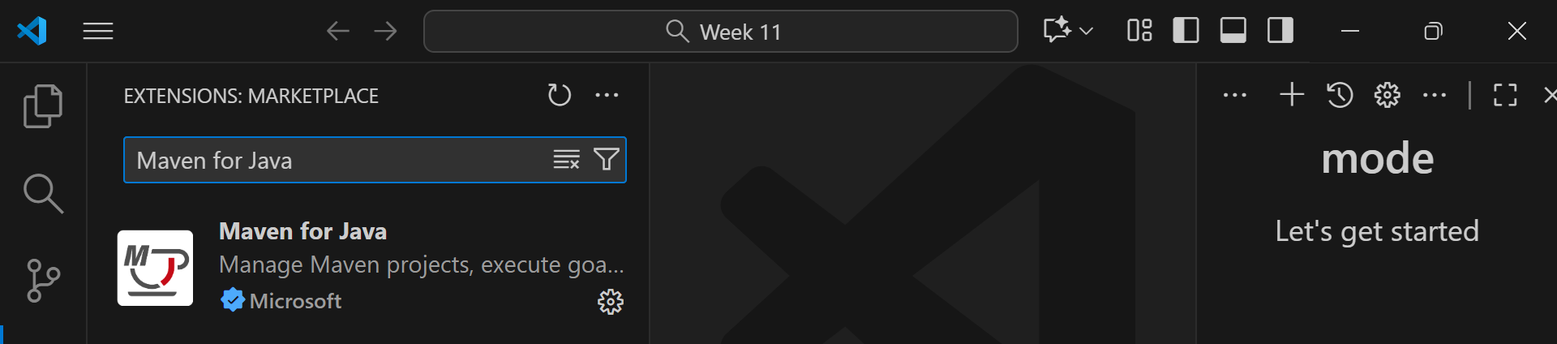
Creating Your First JavaFX Window and Handling Common Errors
Maven for Java (recommended)
Why: Handles dependencies like JavaFX libraries automatically — no need to manually configure module paths; ideal for large multi-file apps such as GUIUniApp or DeskBankApp.

Slide 25
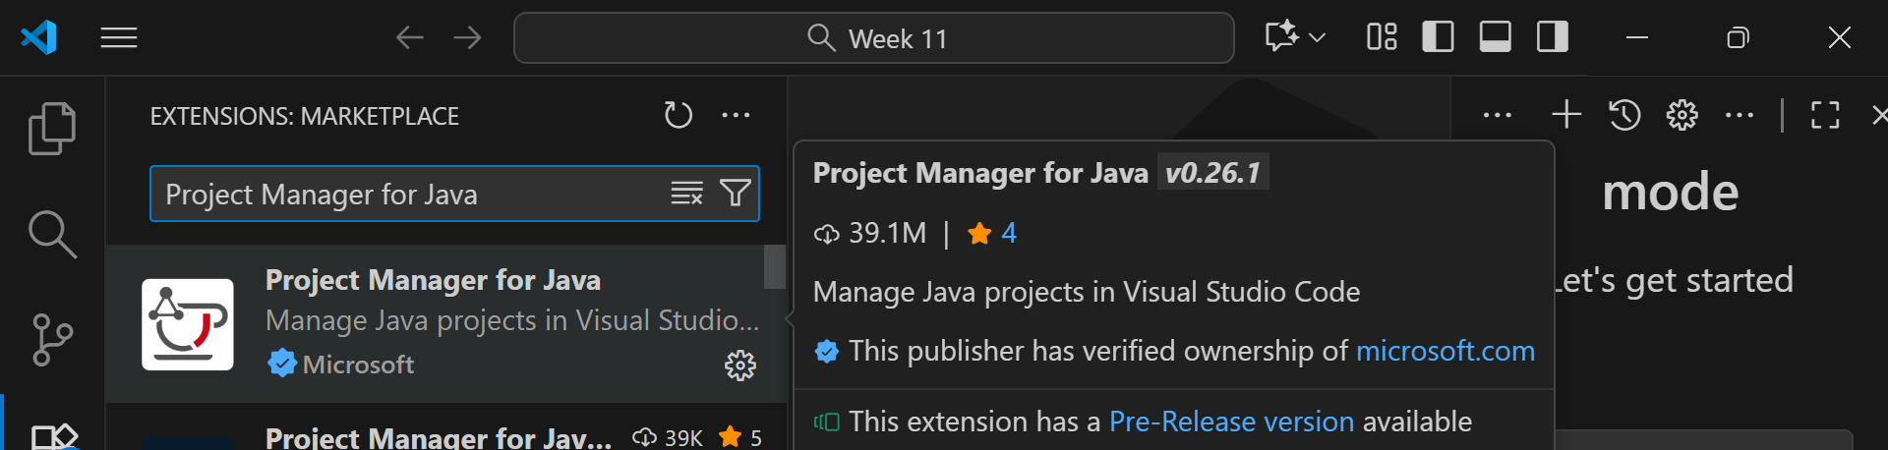
Creating Your First JavaFX Window and Handling Common Errors
Project Manager for Java (Microsoft)
If “Java: Ready” doesn’t appear in the bottom bar, restart VS Code.
Why: Helps organise and manage multiple classes (Student, Subject, Database, Controller, etc.) inside one folder — crucial for team projects in Assessment 1.

Slide 26
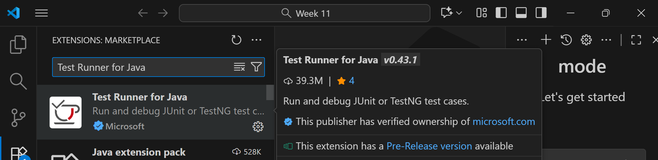
Creating Your First JavaFX Window and Handling Common Errors
Test Runner for Java
Why: Enables quick execution of JUnit or simple logic tests to verify password validation, regex checks, or exception handling in your code.

Slide 27
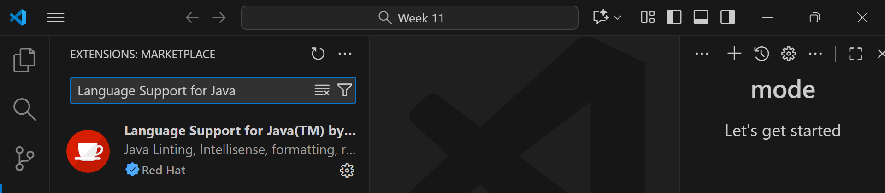
Creating Your First JavaFX Window and Handling Common Errors
Language Support for Java™ by Red Hat
Why: Provides smart IntelliSense (auto-completion, syntax checking, refactoring, and formatting).
Yes, the Red Hat one in your screenshot is the correct and official versio

Slide 28
Creating Your First JavaFX Window and Handling Common Errors
In summary
Extension | Purpose for Assessment 1 Part 2 & 3
Extension Pack for Java | All-in-one setup (installs everything below)
Debugger for Java | Test and debug your GUI / CLI logic
Maven for Java | Add & manage JavaFX dependencies easily
Project Manager for Java | Structure large multi-class projects
Test Runner for Java | Validate logic & exceptions quickly
Language Support for Java™ by Red Hat | Smart coding help and syntax checking

Slide 29
Creating Your First JavaFX Window and Handling Common Errors
If we simply install Extension Pack for Java (by Microsoft), it will automatically include all the others — then we just need to restart VS Code, open our project folder, and we’re ready to start building our GUIBankApp / GUIUniApp.

Slide 30
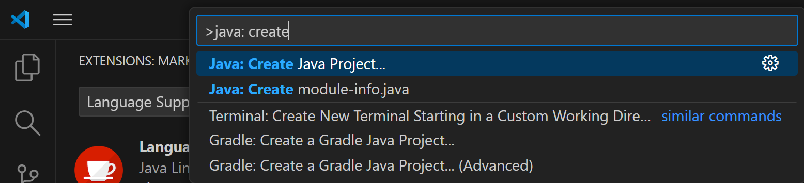
Creating Your First JavaFX Window and Handling Common Errors
Use a Proper Java Project
Press Ctrl+Shift+P → “Java: Create Java Project”

Slide 31
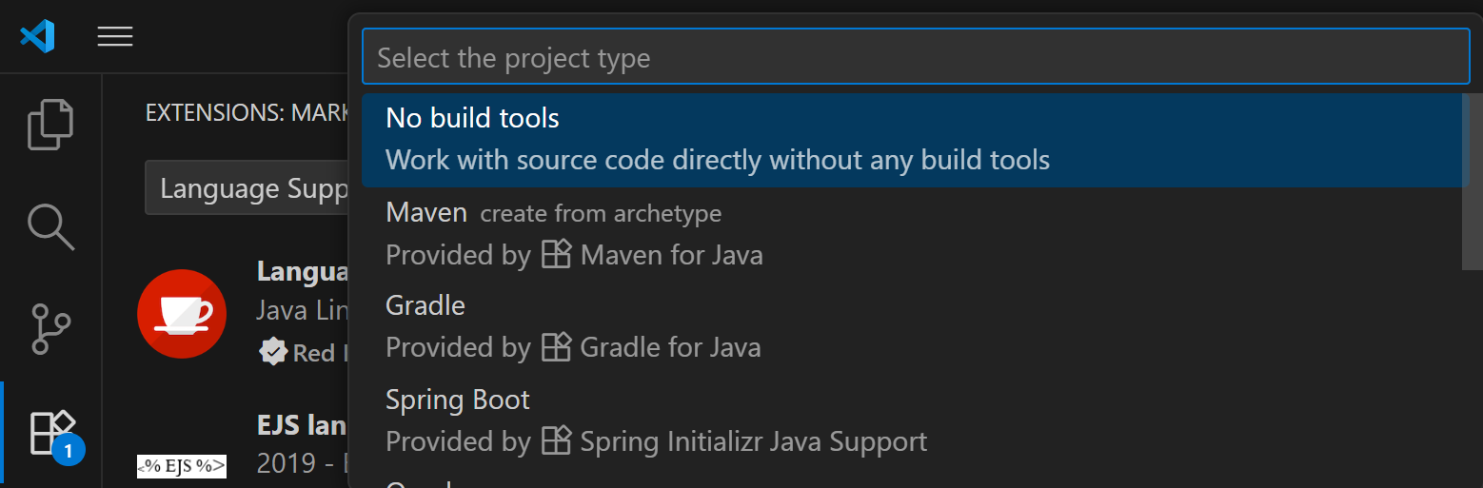
Creating Your First JavaFX Window and Handling Common Errors
Use a Proper Java Project
Choose No build tools (for simple) or Maven (for advanced). For a simple “Hello JavaFX” or small Week 11 lab, choose → “No build tools.”
For Assessment 1 Part 2 & 3 (GUIUniApp) choose Maven

Slide 32
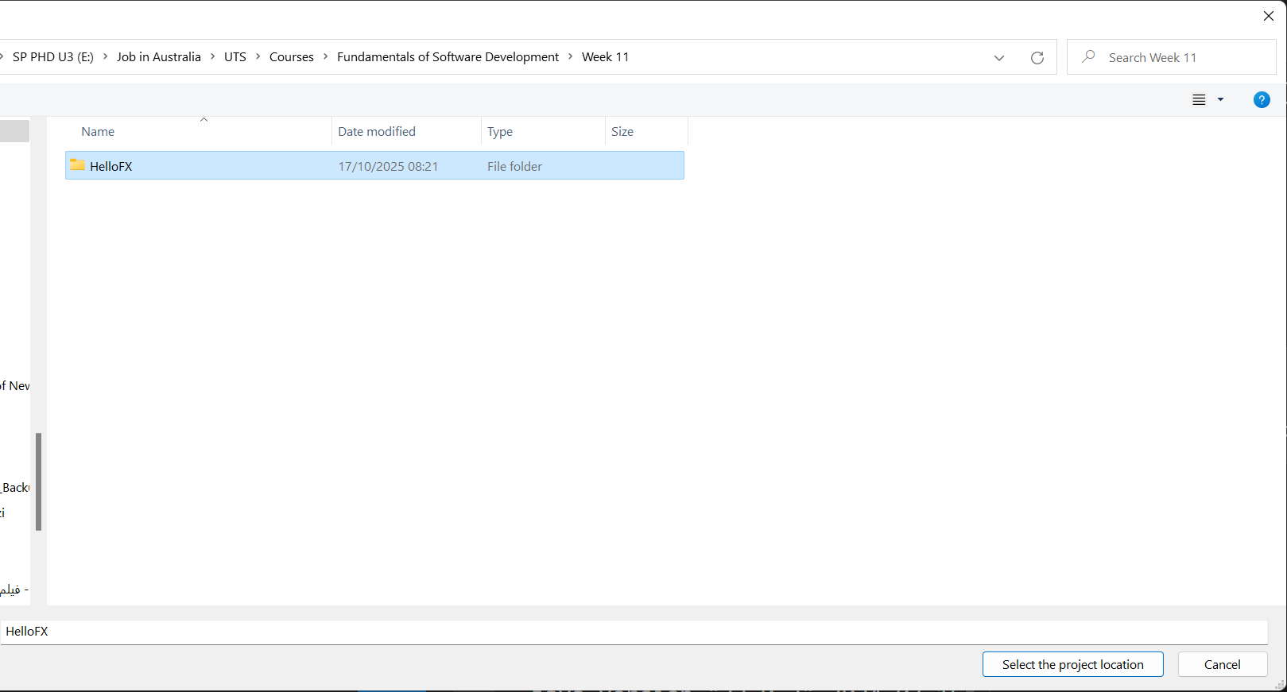
Creating Your First JavaFX Window and Handling Common Errors
Click “New Folder” : HelloFX This will be our simple project folder.

Slide 33
Creating Your First JavaFX Window and Handling Common Errors
Select the folder we just created → click “Select the project location.”
VS Code will now create a project structure under:
E:\Job in Australia\UTS\Courses\Fundamentals of Software Development\Week 11\HelloFX

Slide 34
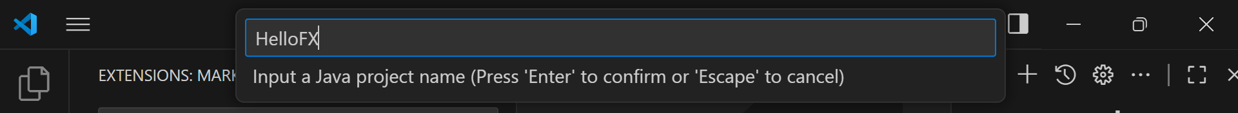
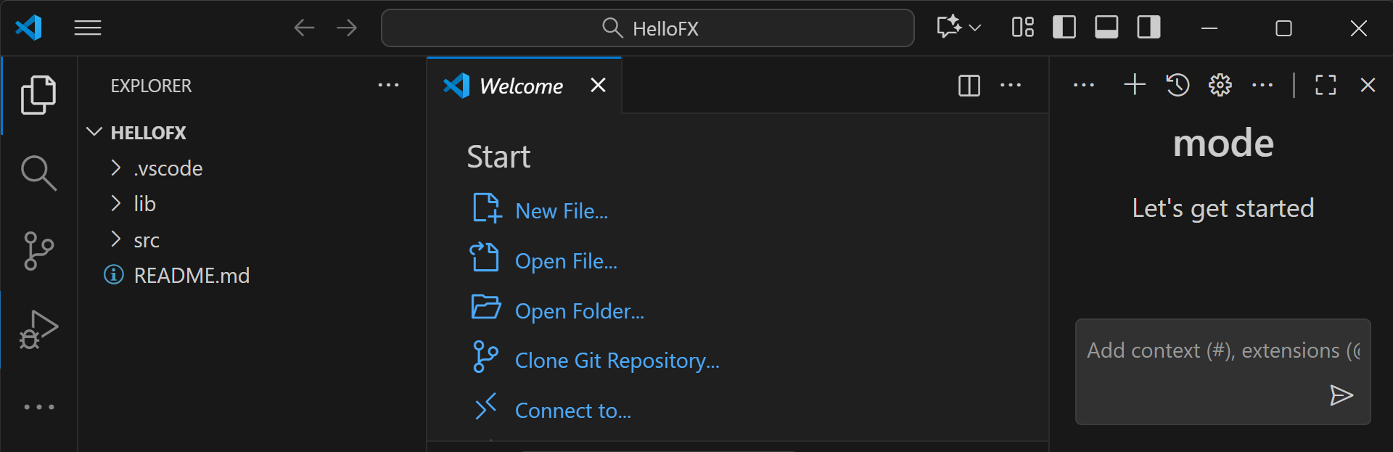
Creating Your First JavaFX Window and Handling Common Errors
Choose a Name (e.g., HelloFX) and press Enter
Wait a few seconds → VS Code will open that folder automatically.
We should see the folder name appear in the left sidebar (Explorer).

Slide 35
Creating Your First JavaFX Window and Handling Common Errors
Use this for: quick practice (e.g., HelloFX.java, one or two files).
How it works: VS Code compiles .java files directly using our installed JDK.
Limitation: We must manually configure the JavaFX SDK path or launch.json VM args later.

Slide 36
Creating Your First JavaFX Window and Handling Common Errors
Why for Assessment 1 Part 2&3: Maven automatically manages dependencies (like javafx-controls, javafx-fxml), project structure, and build scripts.
Benefit: You just add JavaFX dependencies in pom.xml; no manual module-path setup.

Slide 37
Creating Your First JavaFX Window and Handling Common Errors
Example folder structure for Assessment 1 Part 2&3 it creates:
GUIUniApp/
|── pom.xml
└── src/main/java/edu/uts/guiuniapp/App.java
Maven keeps our model–controller–view code organised, handles .jar packaging, and is exactly what real industry IDEs use for JavaFX + file-based systems.

Slide 38
Creating Your First JavaFX Window and Handling Common Errors
Purpose | Option | Use When | Pros | Cons
Week 11 HelloFX | No build tools | Single-file demo | Quick setup | Manual JavaFX path setup
Assessment 1 Part 2 & 3 (GUIUniApp) | Maven | Multi-class project with dependencies | Auto-manages JavaFX libs, structured, scalable | Slightly more setup (one-time)

Slide 39
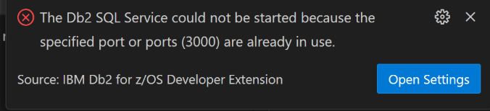
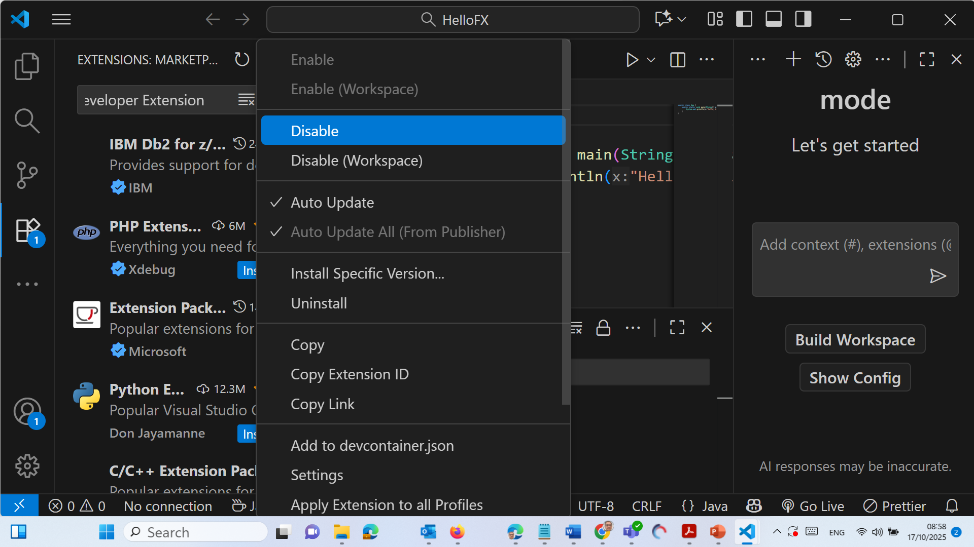
Creating Your First JavaFX Window and Handling Common Errors
If you see this warning, then:
Go to Extensions (Ctrl + Shift + X)
Search for IBM Db2 for z/OS Developer Extension
Click → Disable
Then continue — it won’t affect your JavaFX project.

Slide 40
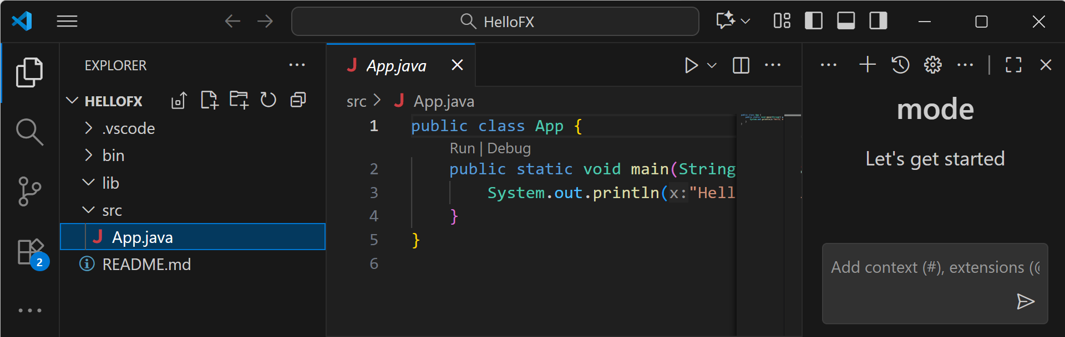
Creating Your First JavaFX Window and Handling Common Errors
Here is out Folder Setup

Slide 41
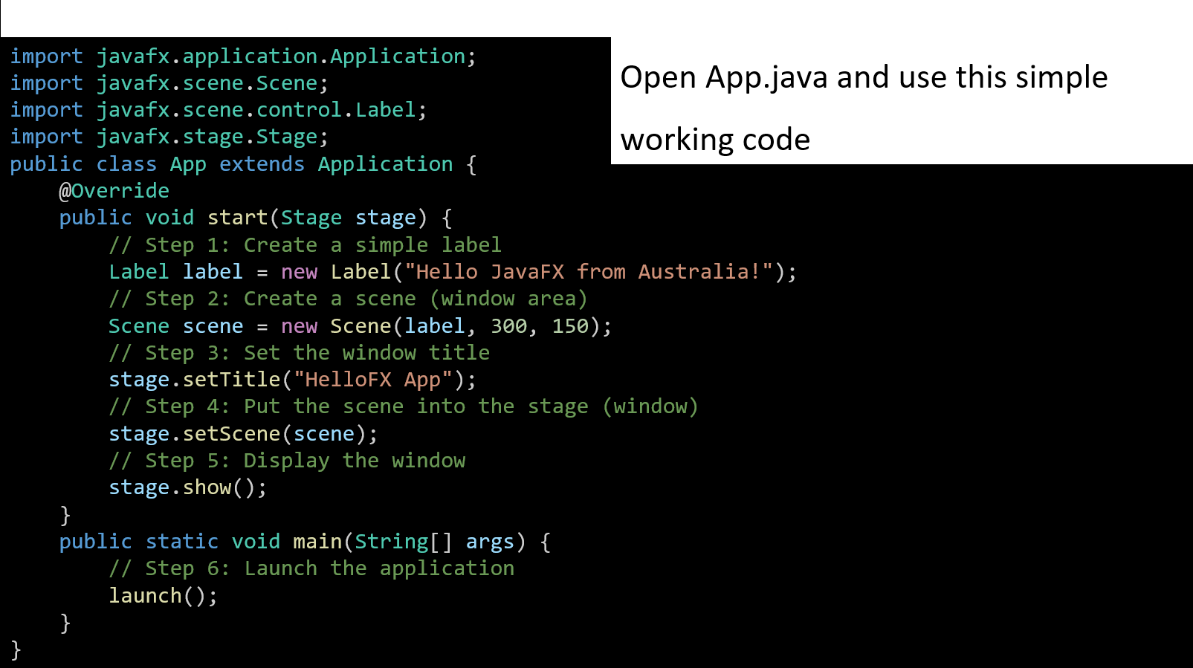

Slide 42
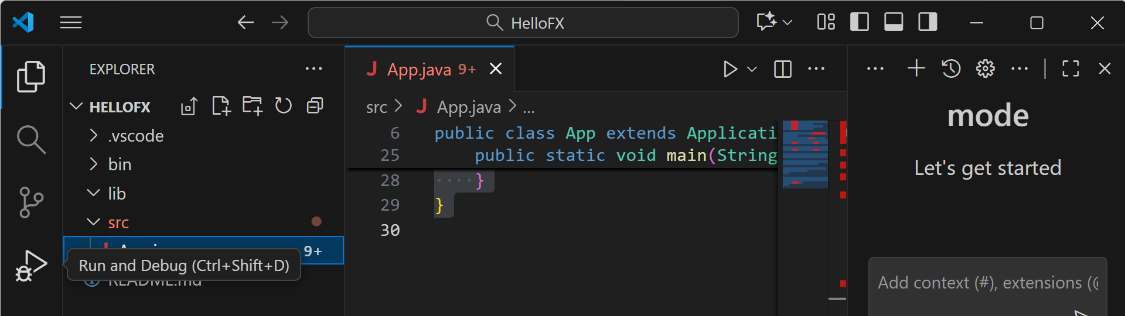
Creating Your First JavaFX Window and Handling Common Errors
Configure VS Code to Run JavaFX
On the left sidebar → click the Run and Debug icon (Ctrl + Shift + D)

Slide 43
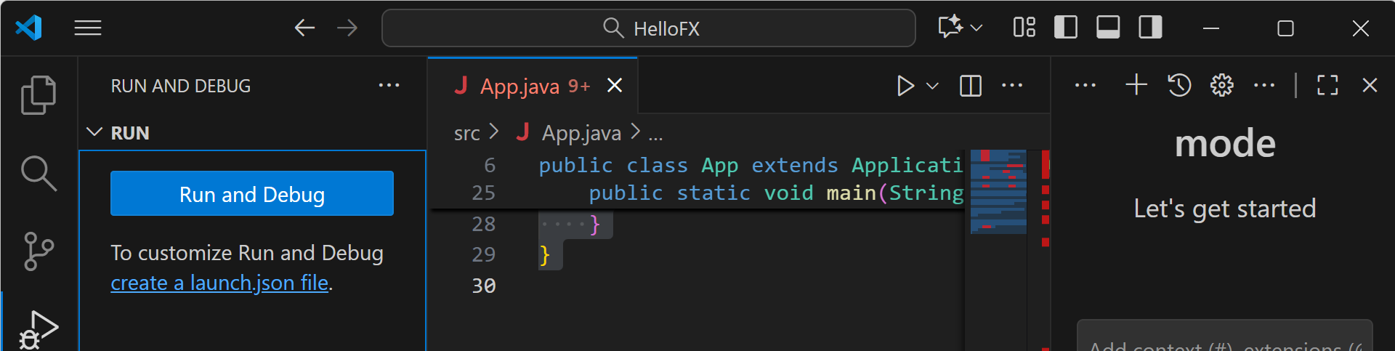
Creating Your First JavaFX Window and Handling Common Errors
Click “create a launch.json file” → choose Java

Slide 44
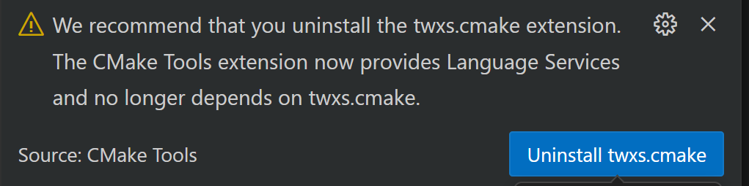
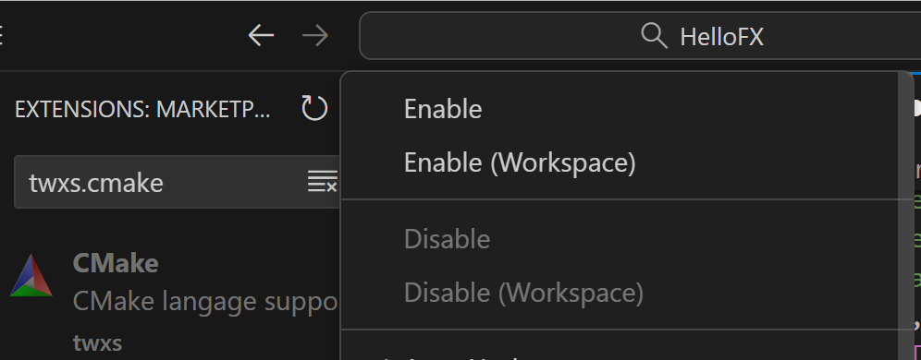
Creating Your First JavaFX Window and Handling Common Errors
Disable CMake

Slide 45
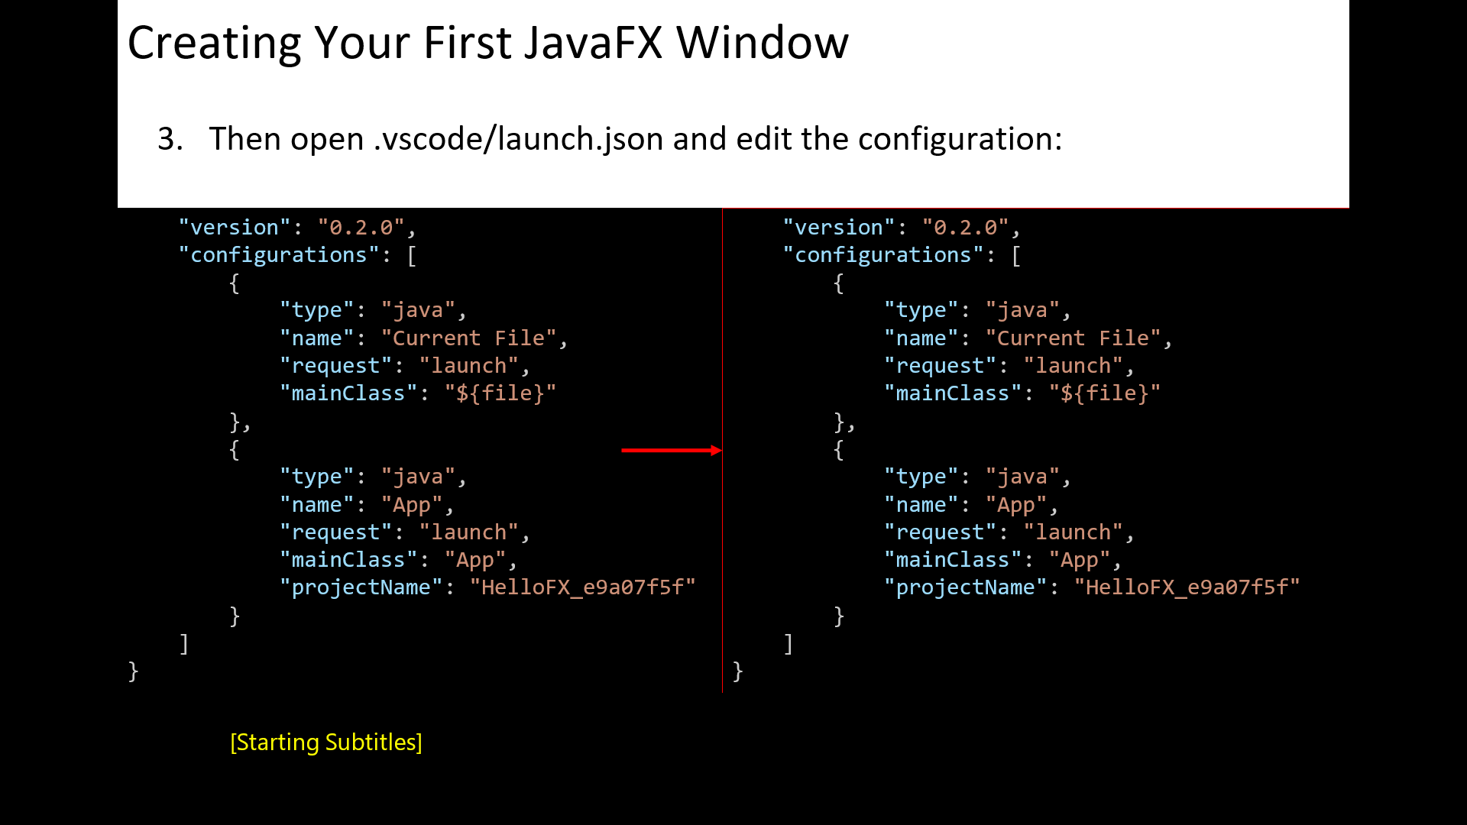

Slide 46
Setting | What it means
"type": "java" | Tells VS Code this is a Java run configuration.
"name" | The name shown in the Run and Debug dropdown.
"request": "launch" | Run directly (not attach).
"mainClass": "App" | The class that has the main() method.
"cwd" | Current working directory → your src folder.
"vmArgs" | Tells Java where the JavaFX SDK lib folder is and which modules to load.

Slide 47
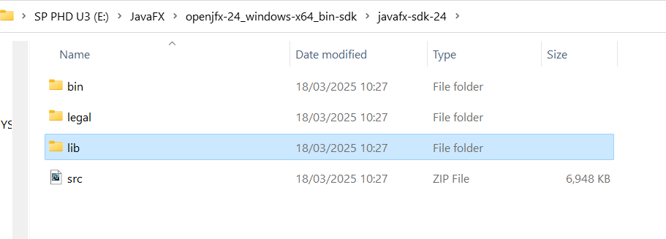
Creating Your First JavaFX Window and Handling Common Errors
Locate your JavaFX SDK /lib path
If we already downloaded JavaFX SDK (e.g. javafx-sdk-21):
Open File Explorer → go to
C:\ or E:\Downloads and search for javafx-sdk.
When we find it, open the folder — we’ll see something like
javafx-sdk-21/
├ bin/
├ legal/
├ lib/ ← THIS is the path we need
└─ readme.html

Slide 48
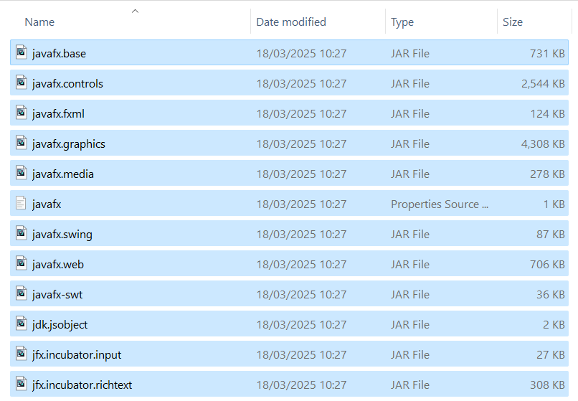
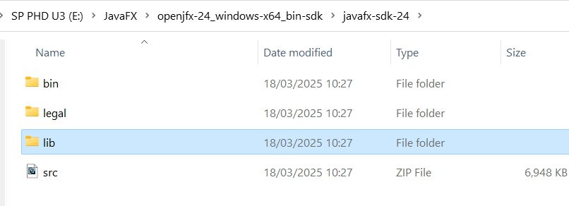
Creating Your First JavaFX Window and Handling Common Errors
Copy that full path, e.g.
E:\JavaFX\openjfx-24_windows-x64_bin-sdk\javafx-sdk-24\lib
If we prefer to keep everything inside our project, copy that lib folder into
E:\Job in Australia\UTS\Courses\Fundamentals of Software Development\Week 11\HelloFX\HelloFX\lib

Slide 49
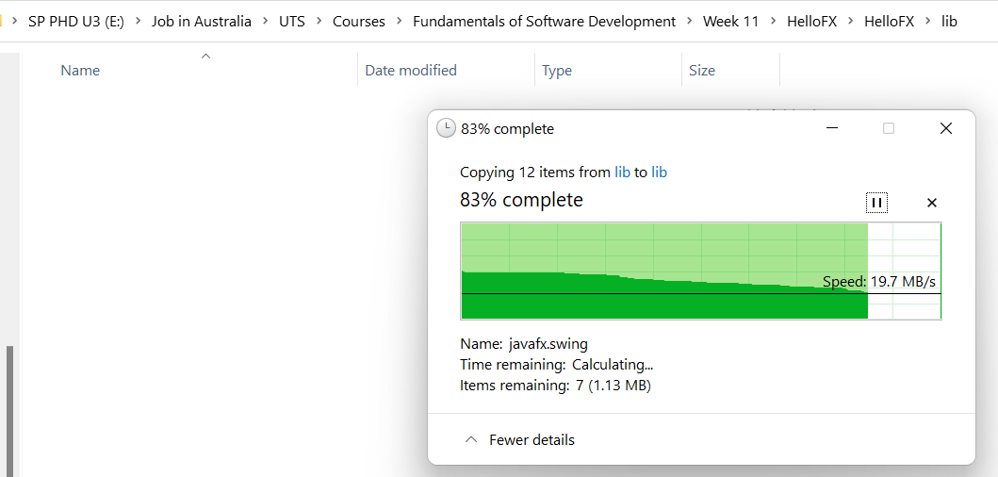
Creating Your First JavaFX Window and Handling Common Errors
Since we copied all .jar files from
E:\JavaFX\openjfx-24_windows-x64_bin-sdk\javafx-sdk-24\lib
to our project folder:
E:\Job in Australia\UTS\Courses\Fundamentals of Software Development\Week 11\HelloFX\HelloFX\lib
we can now safely update our
launch.json file.

Slide 50
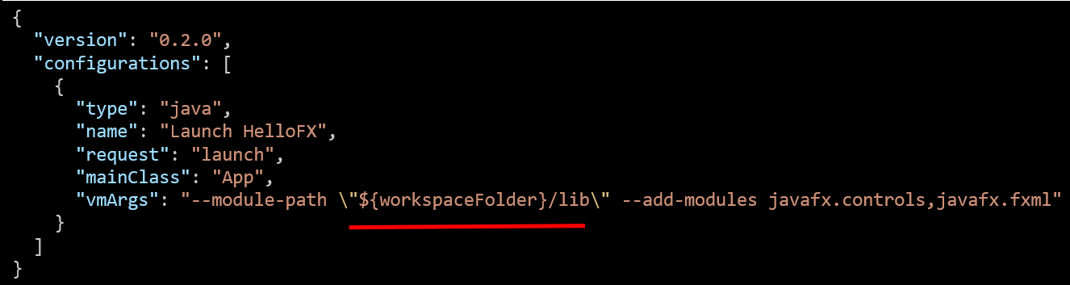
Creating Your First JavaFX Window and Handling Common Errors
We use this content for launch.json
Key | Description
"type": "java" | Tells VS Code this is a Java program.
"mainClass": "App" | Runs your App.java class that has main().
"vmArgs" | Tells Java to include the JavaFX library (from your lib folder) and use two modules — javafx.controls and javafx.fxml.
"${workspaceFolder}/lib" | Automatically points to your lib folder inside the HelloFX project, no need to hardcode the long E:\... path.

Slide 51
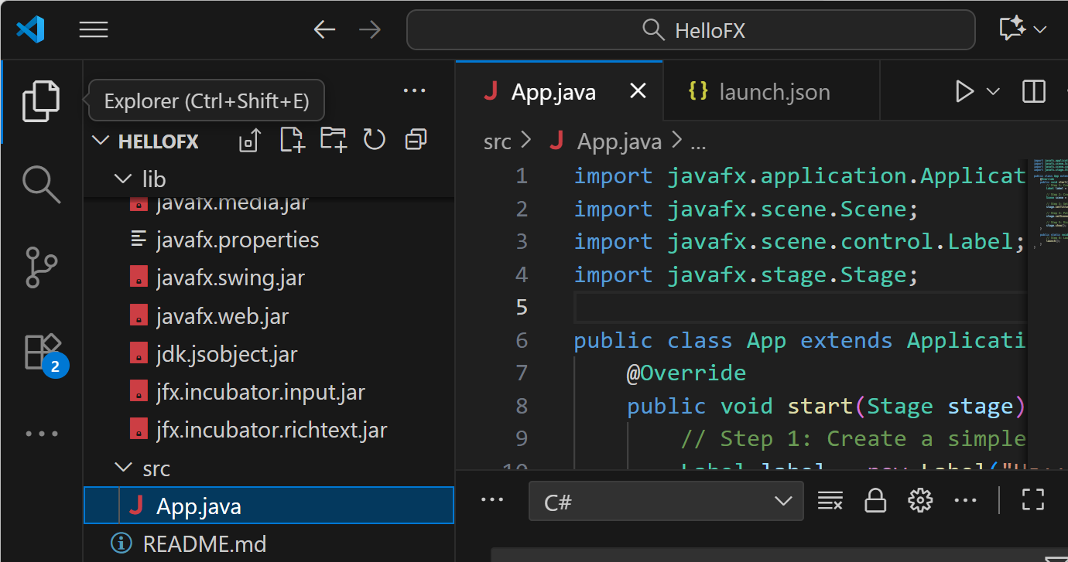
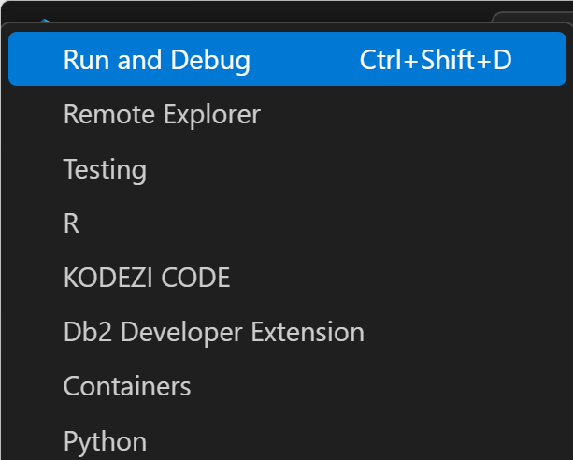
Creating Your First JavaFX Window and Handling Common Errors
Explorer >> src (double click)
Save and Run App.java (Ctrl + Shift + D)

Slide 52
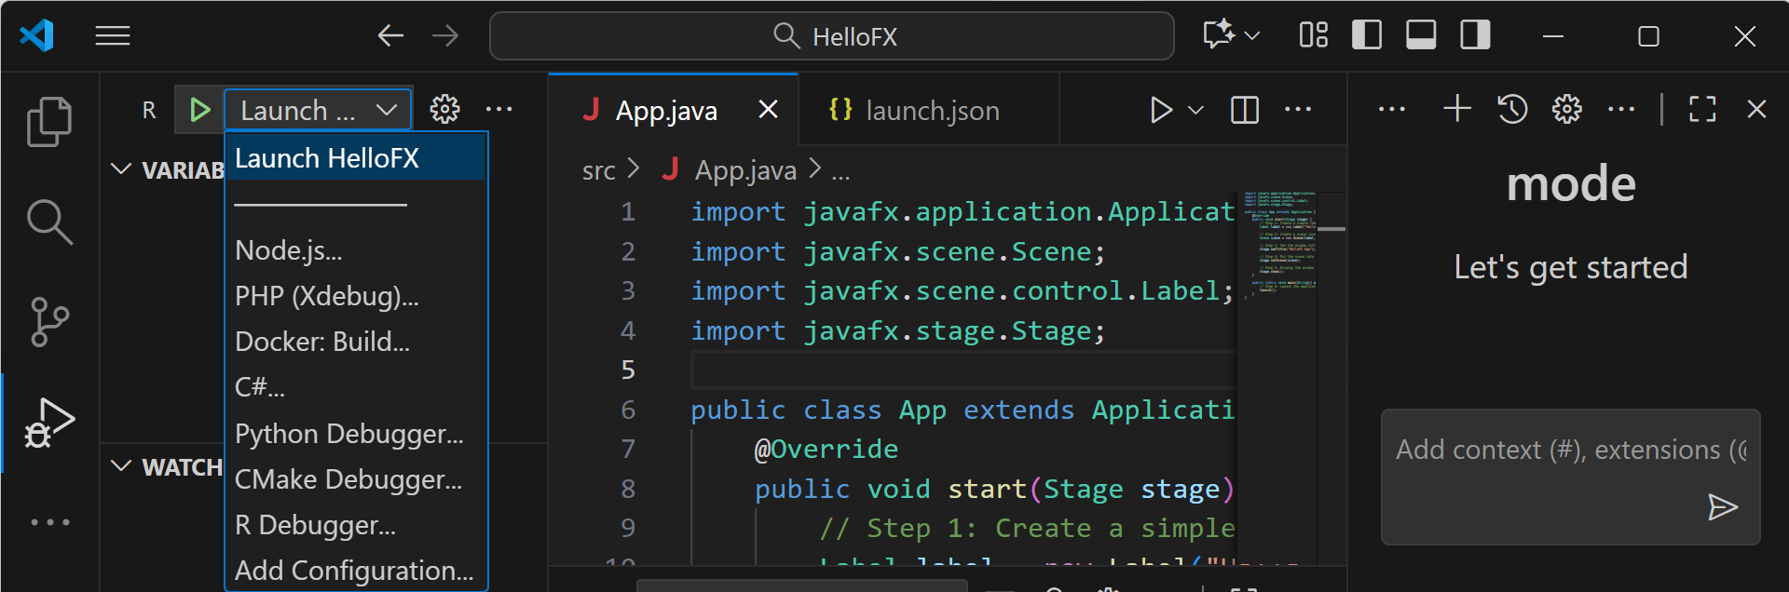
Creating Your First JavaFX Window and Handling Common Errors
Select Launch HelloFX

Slide 53
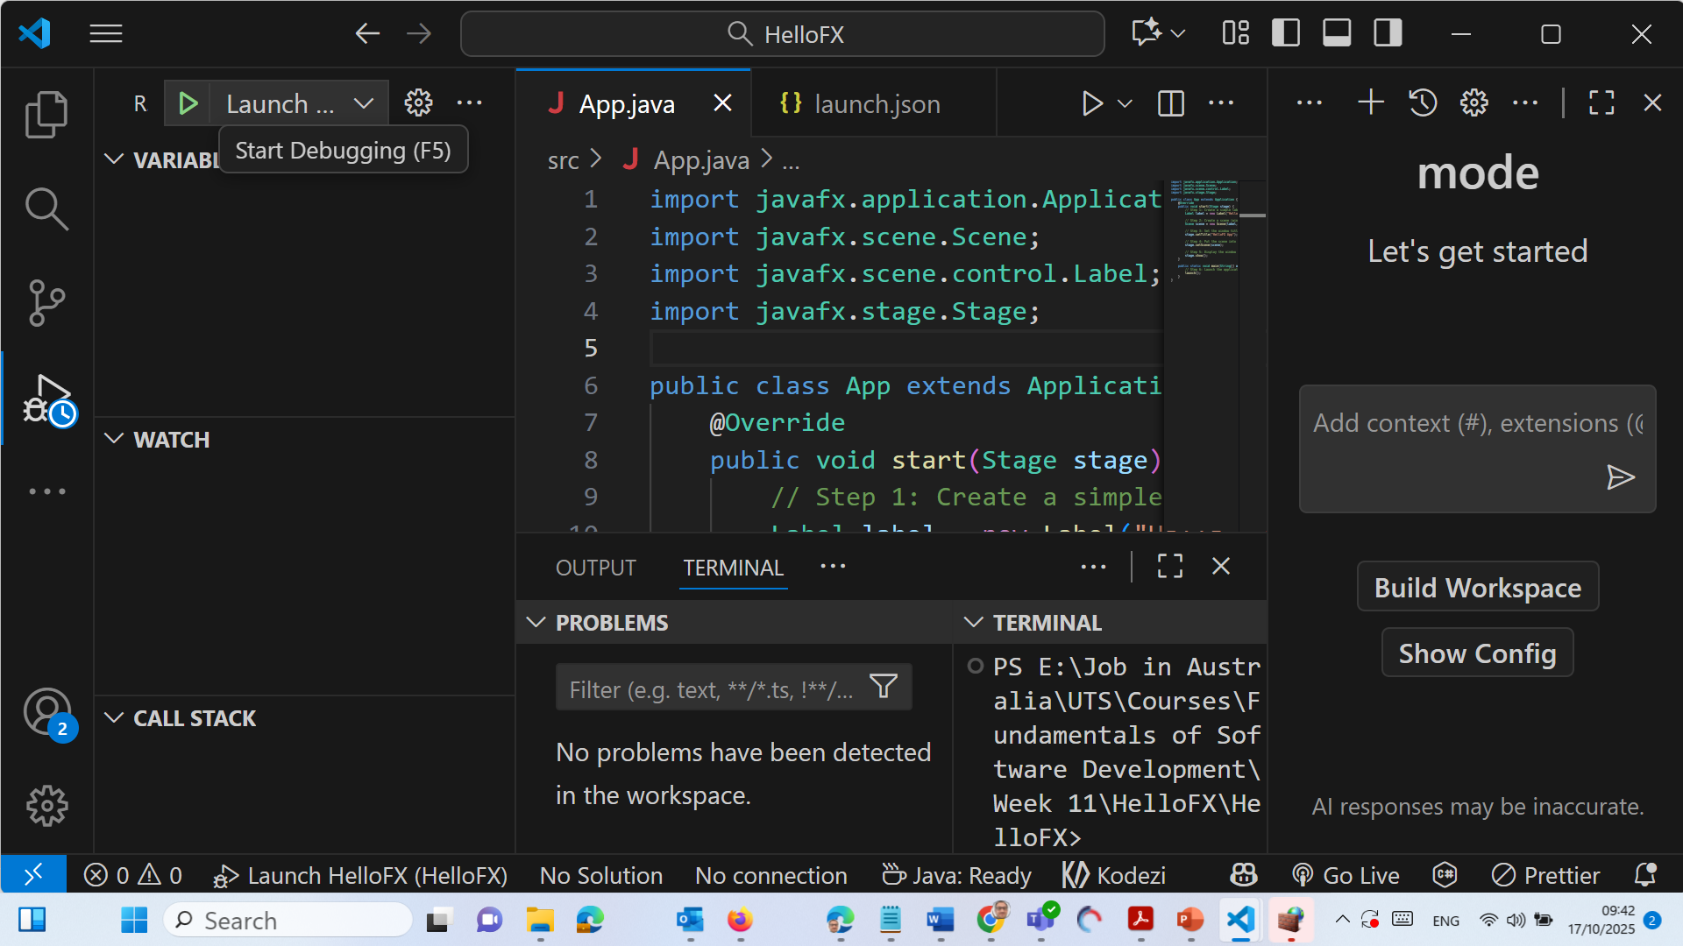
Creating Your First JavaFX Window and Handling Common Errors
F5 (Start Debugging)

Slide 54
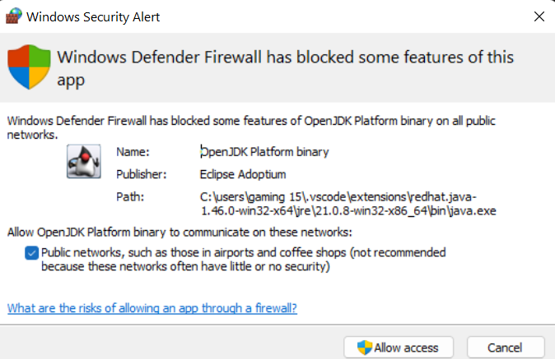
Creating Your First JavaFX Window and Handling Common Errors
Allow Access

Slide 55
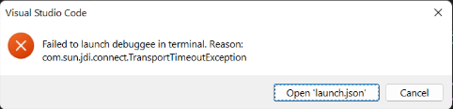
Creating Your First JavaFX Window and Handling Common Errors
“TransportTimeoutException” is a common VS Code JavaFX setup issue.
It usually means the debugger can’t connect because the JavaFX runtime or the project path isn’t configured quite right.

Slide 56
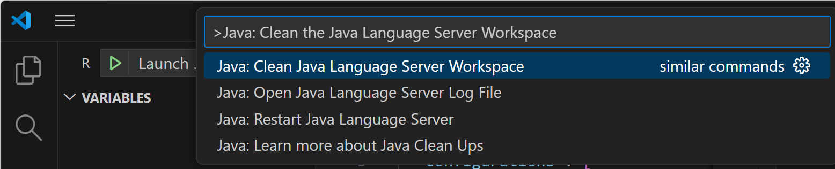
Creating Your First JavaFX Window and Handling Common Errors
Close the running debug session
In VS Code:
Click Stop (Terminate) if any debug session is active.
Then click View → Command Palette → Java: Clean the Java Language Server Workspace.

Slide 57
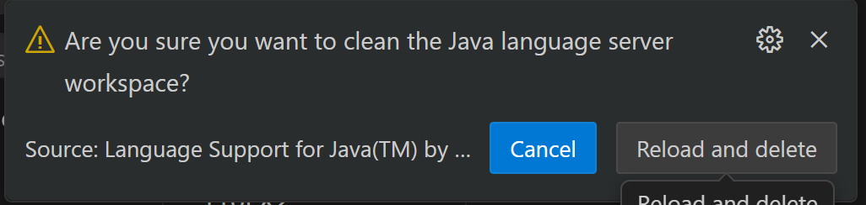
Creating Your First JavaFX Window and Handling Common Errors
When prompted, select Restart.
This resets VS Code’s Java environment.

Slide 58
Creating Your First JavaFX Window and Handling Common Errors
{
"version": "0.2.0",
"configurations": [
{
"type": "java",
"name": "Launch HelloFX",
"request": "launch",
"mainClass": "App",
"cwd": "${workspaceFolder}/src",
"vmArgs": "--module-path \"${workspaceFolder}/lib\" --add-modules javafx.controls,javafx.fxml",
"console": "integratedTerminal"
}
]
}
"cwd": "${workspaceFolder}/src" ensures Java runs from your src folder.
"console": "integratedTerminal" forces VS Code to run it in the main terminal instead of a debugger shell (which prevents timeout).
We check our launch.json
We already have the right structure —we make it explicit to fix path and startup timing issues.
Use this file content (adjusted for our exact folder layout)

Slide 59
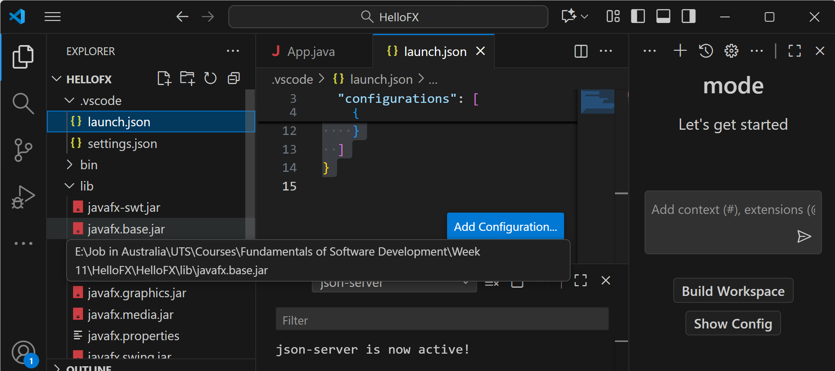
Creating Your First JavaFX Window and Handling Common Errors
The Explorer should include our jar files

Slide 60
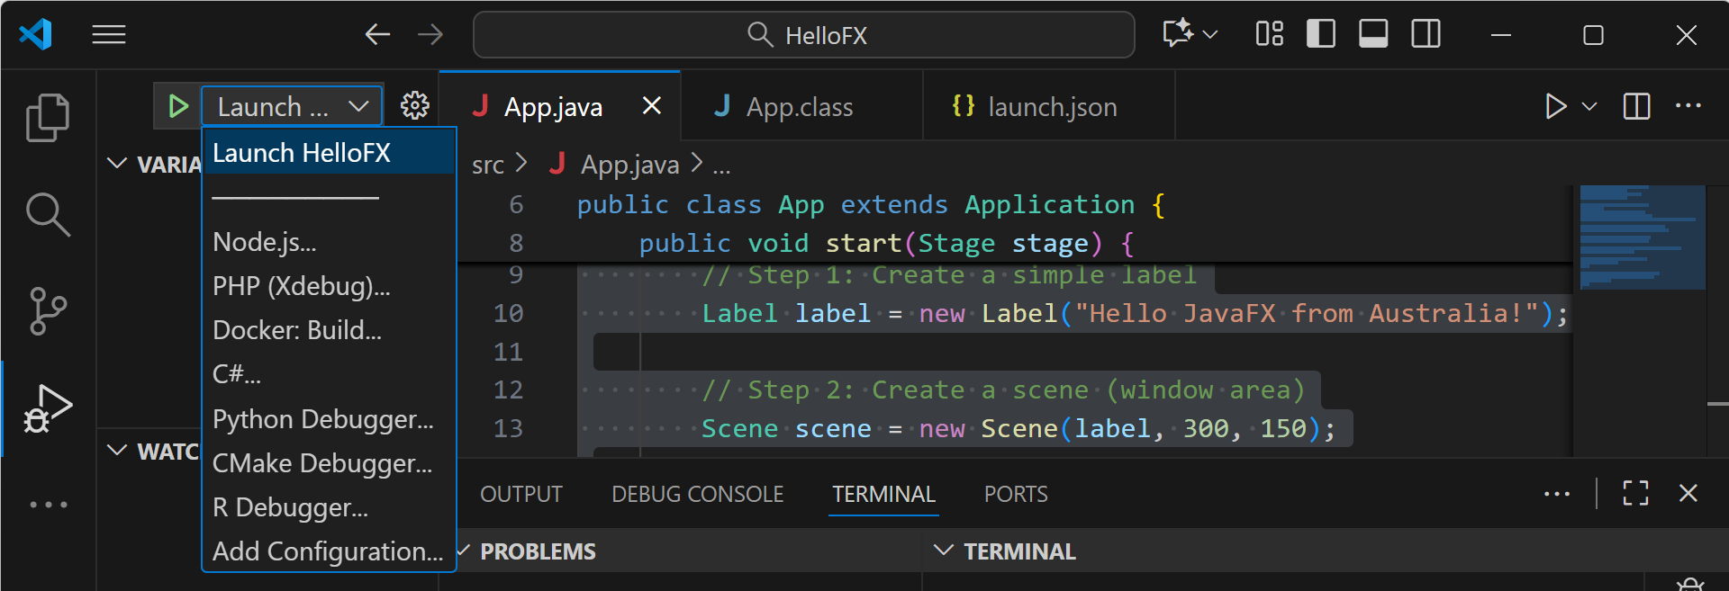
Creating Your First JavaFX Window and Handling Common Errors
Run it (Ctrl + Shift + D)

Slide 61
Creating Your First JavaFX Window and Handling Common Errors
If you see this Error:
InvalidModuleDescriptorException: Unsupported major.minor version 66.0
This means:
You’re using Java 21 (jdk-21).
But your JavaFX 24 SDK was compiled for Java 22 or later (major version 66).
Java 21 can’t understand class files built with 66.0, so it fails during startup.

Slide 62
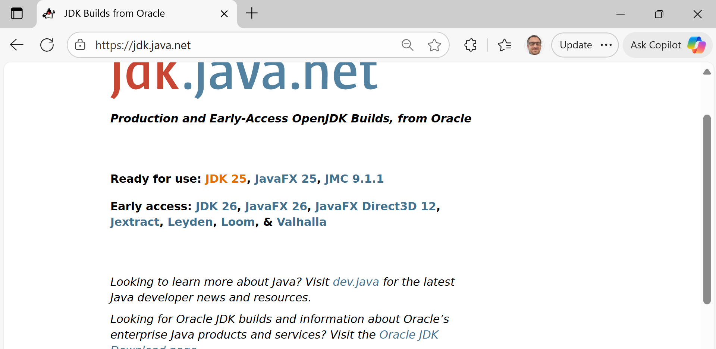
Creating Your First JavaFX Window and Handling Common Errors
Upgrade to JDK 22 or 23
To avoid version mismatches and errors like the one you just saw, both the JDK (Java Development Kit) and JavaFX SDK must come from the same generation.
Download JDK 25 (the stable GA build)
On the left side of that page, click:

Slide 63
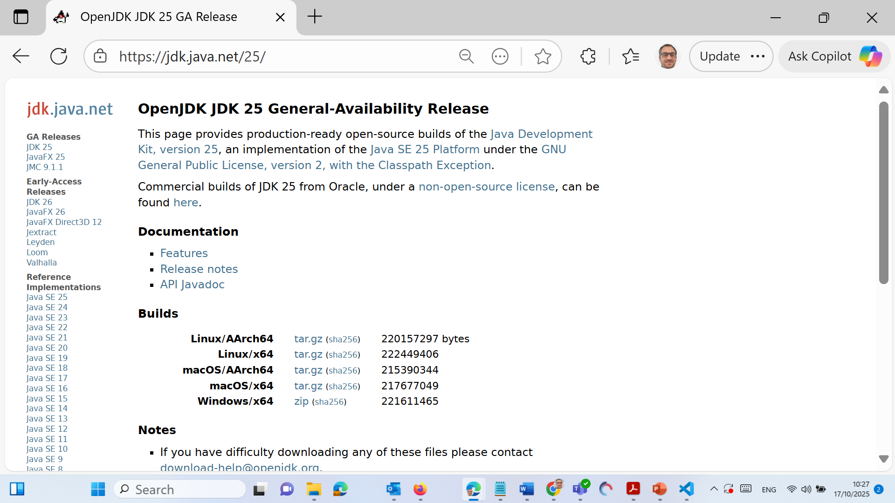
Creating Your First JavaFX Window and Handling Common Errors
Then choose the Windows x64 .zip or .msi installer.
This installs the latest JDK 25, fully stable and compatible with JavaFX 25.

Slide 64
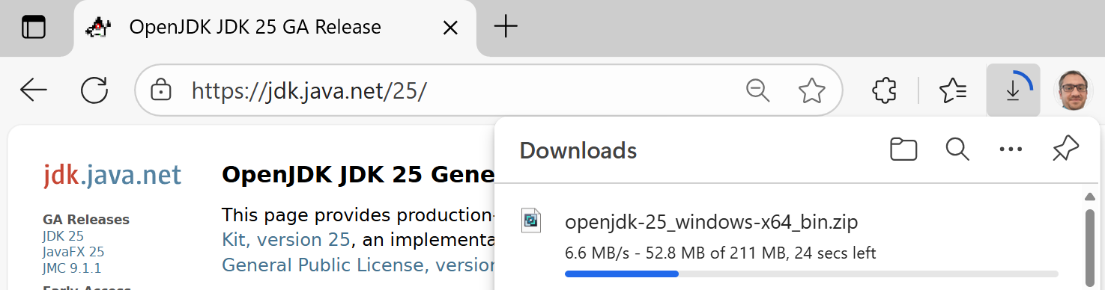
Creating Your First JavaFX Window and Handling Common Errors
Then choose the Windows x64 .zip or .msi installer.
This installs the latest JDK 25, fully stable and compatible with JavaFX 25.

Slide 65
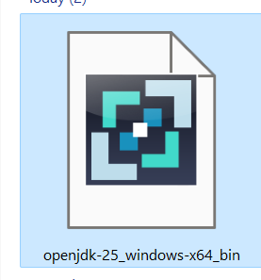
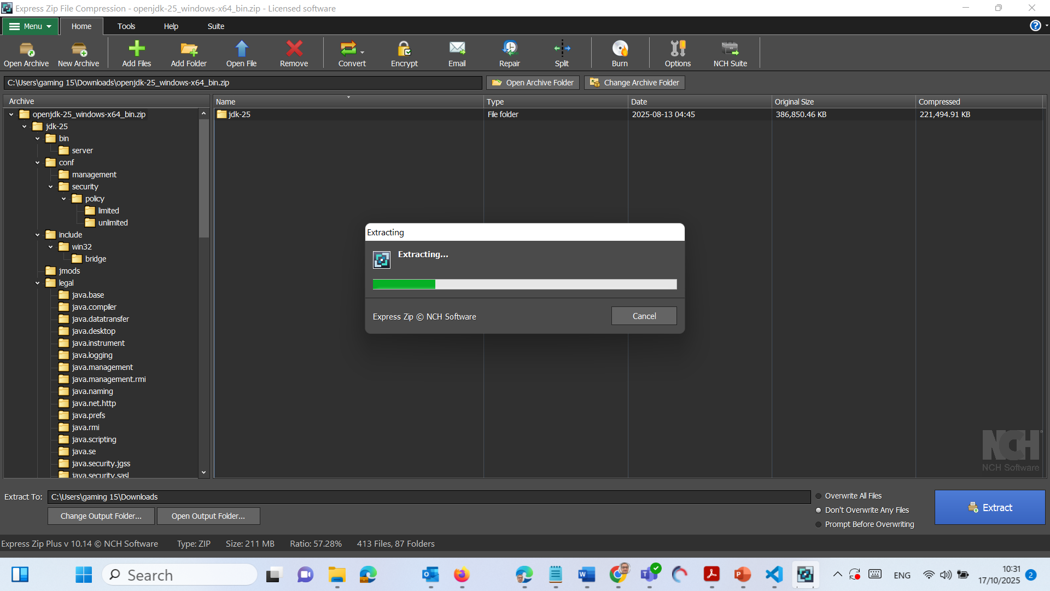
Creating Your First JavaFX Window and Handling Common Errors

Slide 66
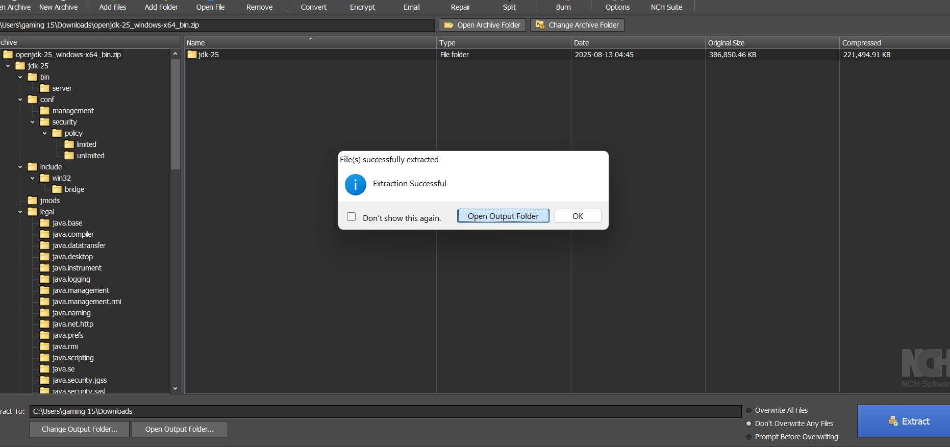
Creating Your First JavaFX Window and Handling Common Errors

Slide 67
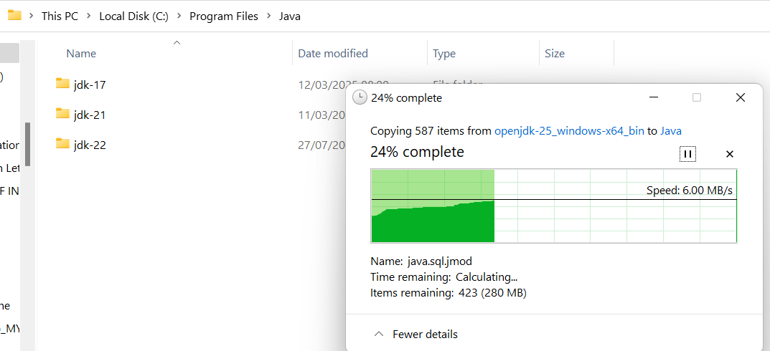
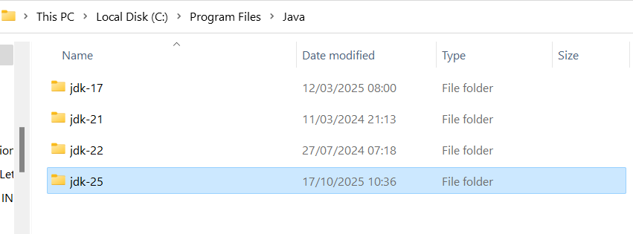
Creating Your First JavaFX Window and Handling Common Errors
Move JDK 25 to a permanent location
Move or extract the folder:

Slide 68

Creating Your First JavaFX Window and Handling Common Errors
Set environment variables
Press Win + S → type Environment Variables → open
“Edit the system environment variables”.

Slide 69

Creating Your First JavaFX Window and Handling Common Errors
Click Environment Variables…

Slide 70

Creating Your First JavaFX Window and Handling Common Errors
→ under System variables, select Path → Edit

Slide 71

Creating Your First JavaFX Window and Handling Common Errors
→ New

Slide 72

Creating Your First JavaFX Window and Handling Common Errors
→ paste our JDK bin path:
Click OK several times to close the windows.

Slide 73

Creating Your First JavaFX Window and Handling Common Errors
Open a new terminal (important — restart it!) and check:
java -version
javac -version

Slide 74

Creating Your First JavaFX Window and Handling Common Errors
Download JavaFX 25 SDK
In the same list, just below, click:

Slide 75

Creating Your First JavaFX Window and Handling Common Errors
Download JavaFX 25 SDK
In the same list, just below, click:

Slide 76

Creating Your First JavaFX Window and Handling Common Errors
Unzip

Slide 77

Creating Your First JavaFX Window and Handling Common Errors
Unzip

Slide 78

Creating Your First JavaFX Window and Handling Common Errors
Unzip

Slide 79

Creating Your First JavaFX Window and Handling Common Errors
Open Output Folder

Slide 80

Creating Your First JavaFX Window and Handling Common Errors
Move it to C:\Program Files\Java

Slide 81

Creating Your First JavaFX Window and Handling Common Errors
Copy all JAR files from lib folder to the lib folder into our project

Slide 82

Creating Your First JavaFX Window and Handling Common Errors
Copy all JAR files from lib folder to the lib folder into our project

Slide 83
Creating Your First JavaFX Window and Handling Common Errors
We can safely delete any older JavaFX-21 or 24 files there.

Slide 84
Creating Your First JavaFX Window and Handling Common Errors
check
You should now have these working together:
Component | Version | Folder
JDK | 25 | C:\Program Files\Java\jdk-25
JavaFX SDK | 25 | C:\JavaFX\javafx-sdk-25\lib (copied to project /lib)
VS Code | Launch.json uses --module-path "${workspaceFolder}/lib" --add-modules javafx.controls,javafx.fxml

Slide 85
Creating Your First JavaFX Window and Handling Common Errors
Launch.JSON (Update)
{
"version": "0.2.0",
"configurations": [
{
"type": "java",
"name": "Launch HelloFX",
"request": "launch",
"mainClass": "App",
"vmArgs": "--module-path \"${workspaceFolder}/lib\" --add-modules javafx.controls,javafx.fxml"
}
]
}
If VS Code asks us to select a JDK, choose
C:\Program Files\Java\jdk-25

Slide 86

Creating Your First JavaFX Window and Handling Common Errors
Update VS Code settings
Press Ctrl + Shift + P → “Java: Configure Java Runtime”
Under Project JDK, select our new:
C:\Program Files\Java\jdk-25

Slide 87
Creating Your First JavaFX Window and Handling Common Errors
Copy all .jar files from
C:\JavaFX\javafx-sdk-25\lib → our project’s
E:\Job in Australia\UTS\Courses\Fundamentals of Software Development\Week 11\HelloFX\HelloFX\lib

Slide 88
Creating Your First JavaFX Window and Handling Common Errors
Rebuild and run
In VS Code → Terminal:
javac --module-path "../lib" --add-modules javafx.controls,javafx.fxml App.java
java --module-path "../lib" --add-modules javafx.controls,javafx.fxml App
We’ll now see our Hello JavaFX from Australia! window open.

Slide 89
Creating Your First JavaFX Window and Handling Common Errors
Summary
Component | Version | Purpose
JDK 25 | Latest GA Release | Runs & compiles your Java code
JavaFX 25 SDK | Same generation | Provides GUI features (Stage, Scene, Label, etc.)
VS Code Extensions | Language Support + Extension Pack for Java | Allows you to build & debug

Slide 90
Creating Your First JavaFX Window and Handling Common Errors
Summary of Setup
Component | Path | Purpose
JDK 25 | C:\Program Files\Java\jdk-25 | Compiles & runs Java
JavaFX SDK 25 | C:\Program Files\Java\javafx-sdk-25 | Provides GUI library jars
Project Lib | E:\...\HelloFX\lib | Contains JavaFX jars for this project
launch.json | Points to ${workspaceFolder}/lib | Tells VS Code how to run the app

Slide 91
MQs designed in Week 11 (JavaFX)
Which JavaFX control is used for single-line text input?
A) Label
B) TextField
C) TextArea
D) PasswordField
Answer: B - Reason: TextField accepts single-line input; TextArea allows multi-line.

Slide 92
MQs designed in Week 11 (JavaFX)
Which container arranges its child nodes vertically?
A) HBox
B) VBox
C) BorderPane
D) GridPane
Answer: B
Reason: VBox stacks nodes one below another.

Slide 93
MQs designed in Week 11 (JavaFX)
Which method launches a JavaFX application?
A) start()
B) init()
C) launch()
D) run()
Answer: C
Reason: Application.launch(args) starts the JavaFX runtime and opens the first stage.

Slide 94
MQs designed in Week 11 (JavaFX)
Which JavaFX control allows users to select one option from a list of choices?
A) RadioButton
B) CheckBox
C) ListView
D) Label
Answer: A
Reason: RadioButton (often grouped in ToggleGroup) provides mutually exclusive selection.

Slide 95
MQs designed in Week 11 (JavaFX)
In an MVC JavaFX app, which component handles ActionEvent from a button?
A) FXML file
B) Controller class
C) Stage
D) Scene
Answer: B
Reason: The controller defines event-handling methods linked via onAction.

Slide 96
MQs designed in Week 11 (JavaFX)
Which FXML tag correctly defines a button label in the UI XML?
A) <Button fx:id="btn" text="Login"/>
B) <Button id="btn" name="Login"/>
C) <Button fx:id="btn">Login</Button>
D) <Button label="Login"/>
Answer: A
Reason: fx:id links the button to the controller variable, and text defines the label text.

Slide 97
MQs designed in Week 11 (JavaFX)
Which FXML tag correctly defines a button label in the UI XML?
A) <Button fx:id="btn" text="Login"/>
B) <Button id="btn" name="Login"/>
C) <Button fx:id="btn">Login</Button>
D) <Button label="Login"/>
Answer: A
Reason: fx:id links the button to the controller variable, and text defines the label text.

Slide 98

Happy Learning and Bright Futures Ahead!
Dr. Farshid Keivanian
Stay Connected:
linkedin.com/in/farshid-keivanian
github.com/FarshidKeivanian
Education is the most powerful weapon you can use to change the world. — Nelson Mandela

